Slide 1
Model-Based Estimation
Lecturer: Ngo Huy Bien
Software Engineering Department
Faculty of Information Technology
VNUHCM - University of Science
Ho Chi Minh City, Vietnam
nhbien@fit.hcmus.edu.vn

Slide 2

Objectives
To estimate size in function points.
To estimate size in use case points.
To estimate size in object points.
To estimate size, cost and schedule using algorithmic models.

Slide 3

Contents
Function point analysis.
Use case points.
Object points.
Algorithmic models.

Slide 4

References
Linda M. Laird, M. Carol Brennan (2006). Software Measurement and Estimation A Practical Approach.
AJ Albrecht (1979). Measuring Application Development Productivity.
CR Symons (1988). Function Point Analysis: Difficulties and Improvements.
Mohammed A. Shayib (2013). Applied Statistics.
N.H. Bingham and John M. Fry. Regression (2010). Linear Models in Statistics.
Robert T. Futrell et al. (2002). Quality Software Project Management.
Daniel D. Galorath (2006). Software Sizing, Estimation, and Risk Management.
Steve McConnell (2006). Software Estimation: Demystifying the Black Art. Microsoft Press.

Slide 5
Function Point Analysis [1, 2, 3]
Function points — FP is a software metric used to measure the delivered functionality in a program from user perspective.
Function point analysis is a standard method for measuring software development from the user’s point of view.

Slide 6
Step 1: Determine Type of Function Point Count
Development project function point count
Enhancement project function point count
Application function point count

Slide 7
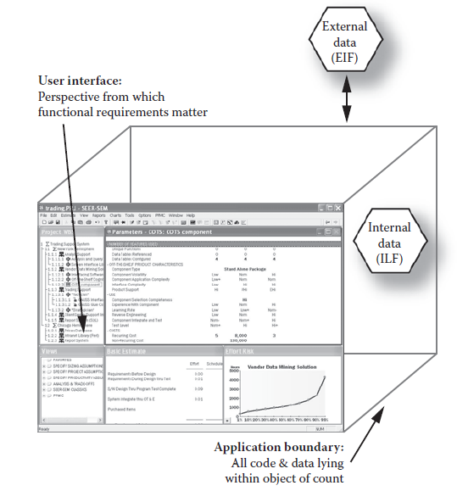
Step 2: Determine Application Boundary

Slide 8
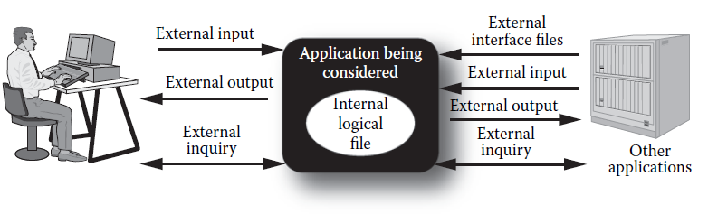
Step 3: Identify Data Functions
The system’s functionality is decomposed into:
Internal Logical File (ILF) – A user-identifiable group of logically related data or control information utilized and maintained by an application (tables, flat files, application control information).
External Interface File (EIF) – A user-identifiable group of logically related data or control information utilized by the application but maintained by another application (tables, flat files, application control information).

Slide 9
Step 4: Identify Transactional Functions
External Inputs (EIs) – Any function or transaction that moves data into an application (data entry by users, data or file feeds by external applications).
External Outputs (EOs) – Any function or transaction that manipulates data and presents it to a user (reports, images).
External Inquiries (EQs) – A unique request that results in the retrieval of data (reports, search).

Slide 10
Step 5: Identify ILF/EIF Complexity
Data Element Types (DETs) – Unique, user-recognizable, non-repeating fields or attributes, including foreign key attributes that enter the boundary of the subsystem or application (fields).
Record Element Types (RETs) – Logical sub-groupings based on the user’s view of the data (0 RET = 1 RET).
ILF/EIF | 1-19 DETs | 20-50 DETs | 51 + DETs
1 RET | Low | Low | Average
2-5 RETs | Low | Average | High
6+ RETs | Average | High | High

Slide 11
Example
Field | Count as a DET
UserId | No
Username | Yes
Password | Yes
AddressId | Yes
Total DETs: 3
Total RETs: 1
Complexity: Low
Field | Count as a DET
AddressId | No
Address | Yes
City | Yes
State | Yes
Zip | Yes
Country | Yes
Total DETs: 5
Total RETs: 0 (1)
Complexity: Low

Slide 12
Step 6: Identify EIs/EOs/EQs Complexity
Data Element Types (DETs) – user-recognizable data elements that are maintained as ILFs by the EIs, appear in the EIs, EQs (data fields, buttons, search).
File Types Referenced (FTRs) – all ILFS and EIFs referenced or maintained during the processing of the EIs/EOs/EQs (tables, flat files).
EI | 1-4 DETs | 5-15 DETs | 16 + DETs
0-1 FTR | Low | Low | Average
2 FTRs | Low | Average | Average
3+ FTRs | Average | High | High
EO/EQ | 1-5 DETs | 6-19 DETs | 19+ DETs
0-1 FTR | Low | Low | Average
2-3 FTRs | Low | Average | High
4+ FTRs | Average | High | High

Slide 13

Example
EI DETs | EI FTRs | Complexity
4 | 2 | Low
EO DETs | EO FTRs | Complexity
2 | 2 | Low

Slide 14
Step 7: Calculate Unadjusted Function Point
Program Characteristic | Low Complexity | Medium Complexity | High Complexity
External Inputs | __ × 3 | __ × 4 | __ × 6
External Outputs | __ × 4 | __ × 5 | __ × 7
External Queries | __ × 3 | __× 4 | __ × 6
Internal Logical Files | __ × 4 | __ × 10 | __ × 15
External Interface Files | __ × 5 | __ × 7 | __ × 10
Unadjusted Function Point (UPFs) = Sum of EI FP, EO FP, EQ FP, ILF FP, EIF FP
Program Characteristic | Low Complexity | Medium Complexity | High Complexity
External Inputs | 1 × 3 = 3 | 0 × 4 = 0 | 0 × 6 = 0
External Outputs | 1 × 4 = 4 | 0× 5 = 0 | 0 × 7 = 0
Internal Logical Files | 3 × 4 = 8 | 1 × 10 = 0 | 0 × 15 = 0
Unadjusted Function Point |  |  | 15

Slide 15
Step 8: Evaluate General System Characteristic
F1 | Reliable back-up and recovery | 0 – 5
F2 | Data communications | 0 – 5
F3 | Distributed functions | 0 – 5
F4 | Performance | 0 – 5
F5 | Heavily used configuration | 0 – 5
F6 | Online data entry | 0 – 5
F7 | Operational ease | 0 – 5
F8 | Online update | 0 – 5
F9 | Complex interface | 0 – 5
F10 | Complex processing | 0 – 5
F11 | Reusability | 0 – 5
F12 | Installation ease | 0 – 5
F13 | Multiple sites | 0 – 5
F14 | Facilitate change | 0 – 5
 | Value adjustment factor (VAF) = 0.65 + 0.01 * Sum(F1,F14)
 | Adjusted function point (AFP) = UFPs * VAF

Slide 16
Convert Function Points To SLOC
 | Programming Statements per Function Point
Language | Minimum (Minus 1 Standard Deviation) | Mode (Most Common Value) | Maximum (Plus 1 Standard Deviation)
Ada 83 | 45 | 80 | 125
Ada 95 | 30 | 50 | 70
C | 60 | 128 | 170
C# | 40 | 55 | 80
C++ | 40 | 55 | 140
Cobol | 65 | 107 | 150
Fortran 90 | 45 | 80 | 125
Fortran 95 | 30 | 71 | 100
Java | 40 | 55 | 80
Macro Assembly | 130 | 213 | 300
Perl | 10 | 20 | 30
Second generation default (Fortran 77, Cobol, Pascal, etc.) | 65 | 107 | 160
Smalltalk | 10 | 20 | 40
SQL | 7 | 13 | 15
Third generation default (Fortran 90, Ada 83, etc.) | 45 | 80 | 125
Microsoft Visual Basic | 15 | 32 | 41

Slide 17

Pros & Cons of FPA
FPA is independent of language used, development platform.
FPA can be executed at the end of each phase/stage of a project.
ISO standard
Labor-intensive method
Requires significant training and experience to be proficient
Functional complexity weights and degrees of influence determined by trial and debate

Slide 18


Slide 19
Use Case Points
System
Use cases
User interface
Database
Scenario
Classes
Actors
Another system via API
Another system via protocol (TCP/IP)
Person via Interface

Slide 20
Unadjusted Use Case Weight – UUCW
Use Case Type | Description | Weight | Number of Use Cases | Result
Simple | A simple user interface and touches only a single database entity; its success scenario has 3 steps or less; its implementation involves less than 5 classes. | 5 | 8 | 40
Average | More interface design and touches 2 or more database entities; between 4 to 7 steps; its implementation involves between 5 to 10 classes. | 10 | 12 | 120
Complex | Involves a complex user interface or processing and touches 3 or more database entities; over seven steps; its implementation involves more than 10 classes. | 15 | 4 | 60
 | Total Unadjusted Use Case Weight |  | Total UUCW | 220

Slide 21
Unadjusted Actor Weight – UAW
Actor Type | Description | Weight | Number of Actors | Result
Simple | The Actor represents another system with a defined API | 1 | 8 | 8
Average | The Actor represents another system interacting through a protocol, like TCP/IP | 2 | 12 | 24
Complex | The Actor is a person interacting via an interface. | 3 | 4 | 12
 | Total Unadjusted Actor Weight |  | Total UAW | 44

Slide 22
Technical Factor
Technical Factor | Description | Weight | Project Perceived Complexity | Calculated Factor (weight*perceived complexity)
T1 | Distributed System | 2 | 5 | 10
T2 | Performance | 1 | 4 | 4
T3 | End User Efficiency | 1 | 2 | 2
T4 | Complex internal Processing | 1 | 4 | 4
T5 | Reusability | 1 | 2 | 2
T6 | Easy to install | 0.5 | 5 | 2
T7 | Easy to use | 0.5 | 3 | 2
T8 | Portable | 2 | 3 | 6
T9 | Easy to change | 1 | 3 | 3
T10 | Concurrent | 1 | 2 | 2
T11 | Special security features | 1 | 2 | 2
T12 | Provides direct access for third parties | 1 | 5 | 5
T13 | Special user training facilities are required | 1 | 3 | 3
 | TCF = 0.6 + (0.01*Total Factor). |  | 0 - 5 | 47 (Total Factor)

Slide 23
Environment Complexity Factor – ECF
Environmental Factor | Description | Weight | Perceived Impact | Calculated Factor (weight*perceived complexity)
E1 | Familiarity with UML | 1.5 | 4 | 6
E2 | Application Experience | 0.5 | 2 | 1
E3 | Object Oriented Experience | 1 | 5 | 5
E4 | Lead analyst capability | 0.5 | 2 | 1
E5 | Motivation | 1 | 1 | 1
E6 | Stable Requirements | 2 | 5 | 10
E7 | Part-time workers | -1 | 0 | 0
E8 | Difficult Programming language | 2 | 1 | 2
Environment Complexity Factor | ECF = 1.4 + (-0.03*Total Factor) |  | Total Factor | 26

Slide 24
Use Case Points
Adjusted Use Case Points
AUCPs = UUCP *TCP * ECF
where
UUCP - Unadjusted Use Case Points = UUCW + UUCA
TCF - Technical Complexity Factor.
ECF - Environment Complexity Factor.
Effort (person-hours) = AUCPs*PF
where the Productivity Factor (PF) is a ratio of the number of man hours per use case point based on past projects. If no historical data has been collected, a figure between 15 and 30 is suggested by industry experts. A typical value is 20.

Slide 25

Pros & Cons of UC Point
Can be done early
Simple, quick, and transparent
The lack of clearly accepted weights

Slide 27
Object Points
The system is decomposed into:
Screens that are displayed
Reports that are produced by the system
Third-generation language (3GL) modules - the number of program modules that must be developed
Object points are NOT the same as object classes.

Slide 28
Determine Complexity
Classify each element instance into simple, medium and difficult complexity levels
Screens | Number and source of data tables
Number of views contained | Total <4 | Total <8 | Total 8+
<3 | simple | simple | medium
3-7 | simple | medium | difficult
8+ | medium | difficult | difficult
Reports | Number and source of data tables
Number of views contained | Total <4 | Total <8 | Total 8+
<3 | simple | simple | medium
3-7 | simple | medium | difficult
8+ | medium | difficult | difficult

Slide 29
New Object Points
Weight the number in each cell using the following table.
Object type | Simple | Medium | Difficult
Screen | 1 | 2 | 3
Report | 2 | 5 | 8
3GL component | - | - | 10
Add all the weighted object instances to get one number, the object points (OP)
Compute the New Object Points to be developed, NOP=(OP) (100-%reuse)/100

Slide 30
Example
Hello world
Hello world
Hello world
Hello World |  | Weighting Simple | Sum
GUI inputs / screen | 1 | 1 | 1
GUI outputs / reports | 3 | 5 | 15
Number of 3 GL-Modules | 1 | 10 | 10
 |  | Object Points | 26
 | Reuse 50% | New Object Points | 13

Slide 31
Effort Estimation
COCOMO II - Application composition model:
Effort (person-month) = NOP/PROD
where Productivity Rate
Developers experience and maturity capability | Very low | Low | Nominal | High | Very high
PROD | 4 | 7 | 13 | 25 | 50

Slide 32

Pros & Cons of Object Point
Can be done early
Simple, quick, and transparent
The lack of clearly accepted weights

Slide 34

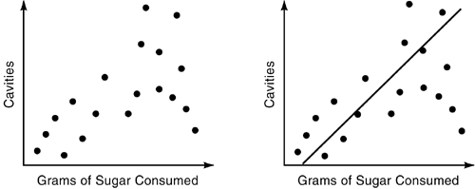
Regression Analysis [4, 5]
The investigator likes to check how variables are related.
Am I able to predict the value of a random variable if I have the value of one or more variables available?
This kind of study is what we call regression analysis.
linear regression
y = a + bx
In multiple regression, the dependent variable is considered to depend on more than a single independent variable.
Scatter Plot
Fitted Line

Slide 35
Example
Temp ⁰C | 0 | 10 | 20 | 30 | 40
Specific Heat | 0.51 | 0.55 | 0.57 | 0.59 | 0.63
Estimate the regression line of specific heat on temperature, and predict the value of the specific heat when the temperature is 25⁰C.
n = 5, ⅀x_{i} = 100, mean of x = 20, ⅀y_{i} = 2.85, mean of y = 0.57
⅀x_{i} y_{i} = 59.8, b₁ = 0.0028, b₀ = 0.514
Hence the fitted equation will be given by ŷ = 0.514 + 0.0028x.
When the temperature x = 25⁰C, the predicted specific heat is 0.514+0.0028*25 = 0.584.

Slide 36
1965 System Development Corporation Cost Model [6]
104 attributes of 169 software projects were collected and treated to extensive statistical analysis.
13-parameter linear estimation model:
MM = -33.63
+ 9.15 (Lack of Requirements) (0-2)
+ 10.73 (Stability of Design) (0-3)
+ 0.51 (Percent Math Instructions)
+ 0.46 (Percent Storage/Retrieval Instructions)
+ 0.40 (Number of Subprograms)
+ 7.28 (Programming Language) (0-1)
- 21.45 (Business Application) (0-1)
+ 13.53 (Stand-Alone Program) (0-1)
+ 12.35 (First Program on Computer) (0-1)
+ 58.82 (Concurrent Hardware Development) (0-1)
+ 30.61 (Random Access Device Used) (0-1)
+ 29.55 (Difference Host, Target Hardware) (0-1)
+ 0.54 (Number of Personnel Trips)
- 25.20 (Developed by Military Organization) (0-1).

Slide 37
The Putnam SLIM Model [6, 7]
With regression modeling, the emphasis is on constructing a formula that best represents scattered data points.
In mathematical modeling, the emphasis is on matching the data to the form of an existing mathematical function.
Based on statistical analysis of several thousand projects, Putnam found that the relationship among the three principal elements of software estimating—size, schedule, and effort—matched the Norden/Rayleigh function.
where
S = software size in LOC
C = environmental factor (constant), dependent on the state of technology
K = total effort for the overall project
t_{d} = delivery time constraint (schedule) in years (development time in years)

Slide 38
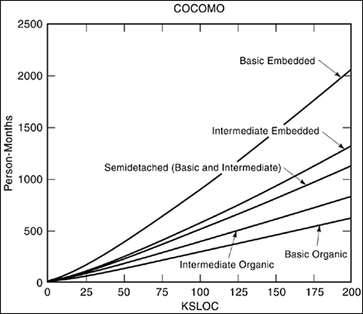
COnstructive COst MOdel
COCOMO is actually a hierarchy of three increasingly detailed models that range from
a single macro-estimation scaling model as a function of product size to
a micro-estimation model with a three-level work breakdown structure and a set of phase-sensitive multipliers for each cost driver attribute.

Slide 39
Project Development Modes
Mode | Product Size | Project/Team Size | Innovation | Deadline and Constraints | Development Environment
Organic | Typically 2–50 KLOC | Small project, small team—development team is familiar with the application language and tools | Little | Not Tight | Stable, In-House
Semi–detached | Typically 50–300 KLOC | Medium project, medium team—team is average in terms of abilities | Medium | Medium | Medium
Embedded | Typically over 300 KLOC | Large project requiring a large team | Greater | Severe Constraints | Complex HW/Customer Interfaces
The organic mode is typified by systems such as payroll, inventory, and scientific calculation.
The semidetached mode is typified by utility systems such as compilers, database systems, and editors.
The embedded mode is typified by real-time systems such as those for air traffic control, ATMs, or weapon systems.

Slide 40
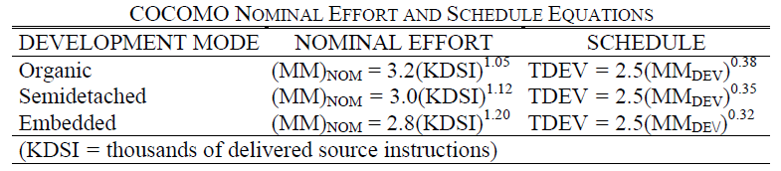
Nominal Effort and Schedule Estimation
Boehm plotted his observed 63 projects.
Basic level of the COnstructive COst MOdel (COCOMO) uses only mode and size to determine the effort and schedule.
It is useful for fast, rough estimates of small to medium-size projects.
MM: man-months
Size = KDSI = thousands of lines of code

Slide 41
COCOMO Example
Suppose we are estimating the cost to develop the microprocessor-based communications processing software
for a highly ambitious new electronic funds transfer network
with high reliability, performance, development schedule, and interface requirements.
We determine that these characteristics best fit the profile of an embedded-mode project.
We next estimate the size of the product as 10,000 delivered source instructions, or 10 KDSI.
We then determine that the nominal development effort for this embedded mode project is
2.8(10)^{1.20} = 44 man-months (MM).

Slide 42
Intermediate Level
Intermediate level uses size, mode, and 15 additional variables to determine effort.
The additional variables are called "cost drivers" and relate to product, personnel, computer, and project attributes that will result in more effort or less effort required for the software project.
Effort (E) = a x (Size)^{b} x C
C: effort adjustment factor (EAF) There are two steps in determining this multiplying factor:
Step 1. is to assign numerical values to the cost drivers.
Step 2. is to multiply the cost drivers together to generate the effort adjustment factor, C.
EAF = C1 x C2 x . . . x Cn, [C_{i} ₌ _{i}^{th} cost adjustment factor]

Slide 43
Detailed Level
Detailed level builds upon intermediate COCOMO by introducing the additional capabilities of phase-sensitive effort multipliers and a three-level product hierarchy.
The program is decomposed into specific products and components of products.
Boehm calls this the three-level product hierarchy:
system, subsystem, and module.
Cost drivers are analyzed separately for each component.
The project development activities are partitioned into phases.
Boehm used four major phases: requirements (RQ), product design (PD), detailed design (DD), and coding and unit test (CUT) for development. Integration and testing (IT) and maintenance (MN) describe the entire life cycle.
Phases may be used to partition systems, subsystems, and/or modules.

Slide 44
COCOMO Drawbacks
Estimation of
object-oriented software,
software created via spiral or evolutionary models, and
applications developed from commercial-off-the-shelf software.
Project size or project staff information

Slide 45
COCOMO II
COCOMO II is a revised and extended version of the model, built upon the original COCOMO.
During the earliest conceptual stages of a project, the model uses object point estimates to compute effort.
During the early design stages, when little is known about project size or project staff, unadjusted function points are used as an input to the model.
After an architecture has been selected, design and development begin with SLOC input to the model.

Slide 46
COCOMO II Models
COCOMO II – The Early Design Model
Converting FPs to KLOC then use
Effort = 2.45*KLOC*EAF
COCOMO II – The Post-Architecture Model
Converting FPs to KLOC then use
Effort = 2.55*KLOC^{B}*EAF

Slide 47
Model Calibration
Calibration is the process of determining the deviation from a standard in order to compute the correction factors.
Items which can be calibrated in a model include:
product types,
operating environments,
labor rates and factors,
various relationships between functional cost items.
Calibration is to
run the model with normal inputs (known parameters such as software lines of code) against items for which the actual cost are known.
These estimates are then compared with the actual costs and the average deviation becomes a correction factor for the model.

Slide 48
Other Models [8]
Albrect–Gaffney: Effort = 13.39 + 0.0545*FP
Kemerer: Effort = 60.62 + 7.728*(10⁻⁸)*FP³
Matson–Barret–Meltichamp: Effort = 585.7 + 15.12*FP
Benchmark: Effort = FP / Delivery Rate.
where Delivery Rate - based on the most recent 600 projects.

Slide 49
Effort Activities Estimation
Requirement
11.30%
A&D
8.25%
Implementation
48.55%
Test
16.05%
Deployment
2.55%
Management
6.15%
Environment
2.03%
SCM
1.86%
SQA
1.80%
Training
0.63%
Defect Prev.
0.85%

Slide 50
Schedule Estimation
Schedule = 3*Effort^{1/3}
Past schedule:
Schedule = PastSchedule*(EstimatedEffort/PastEffort)^{1/3}
Jones's First-Order estimation practice:
Schedule = FPs^{X} where x
Kind of software | Better | Average | Worse
Object-oriented software | 0.33 | 0.36 | 0.39
Client-server software | 0.34 | 0.37 | 0.40
Business systems, internal intranet systems | 0.36 | 0.39 | 0.42
Shrink-wrapped, scientific systems, engineering systems, public internet systems | 0.37 | 0.40 | 0.43
Embedded systems, telecommunications, device drivers, systems software | 0.38 | 0.41 | 0.44

Slide 51

Pros & Cons of Algorithmic Models
Repeatable estimations
Objectively calibrated to previous experience
Various extensions for almost every purpose
Tool support
Poor sizing inputs and inaccurate cost driver rating will result in inaccurate estimation.

Slide 53
Halstead's Software Science (I)
The measurable and countable properties are :
n₁ = number of unique or distinct operators appearing in that implementation
n₂ = number of unique or distinct operands appearing in that implementation
N₁ = total usage of all of the operators appearing in that implementation
N₂ = total usage of all of the operands appearing in that implementation

Slide 54
Halstead's Software Science (II)
The vocabulary n = n₁ + n₂
The implementation length N = N₁ + N₂
Volume V = n₁log₂n₁ + n₂log₂n₂
Difficulity D = (n1/2) * (N₂ / n2)
Effort E = D*V
Schedules S = ( n₁N₂( n₁log₂n₁ + n₂log₂n₂) log₂n) / 2n₂S, where S from 5 to 20.

Slide 55

Pros & Cons of Halstead's Method
Simple to calculate
Can be used for any programming language
Depends on completed code
No predictive

Slide 57
Measurement vs. Rating
A measurement is objective and can be manipulated mathematically.
A rating is subjective and cannot be manipulated mathematically.
FPs, UCPs, OPs are a rating, not a measurement.
1 (2000 FPs Application) = 2 * (1000 FPs Application)???
If a team completes an application of 250 FP in 10 weeks, then they can complete an application 500 FPs in 20 weeks???
How about complexity between 100 FPs application and 50 FPs application???

Slide 59

Further Reading
McCabe's Cyclomatic Number.
Fan-In Fan-Out Complexity - Henry's and Kafura's.
Defects Estimation.
Reliability Estimation.

Slide 60

Thank You & See You Again

